Slide 1
3D Animation Idea Presentation Using Blender
CSE 414
Presented by :
Group – 4 (Sec B)
Muhammad Zubair Hasan (201714041,Sec-B)
Nazifa Hamid (201714044,Sec-B)

Slide 2
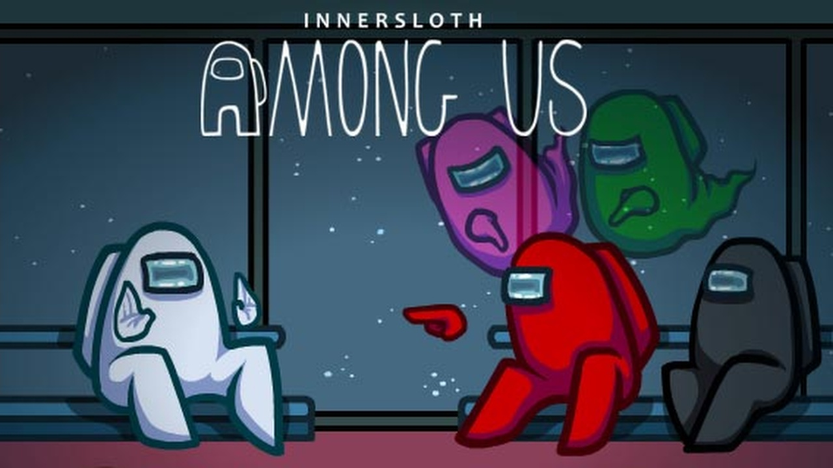
Among US

Slide 3

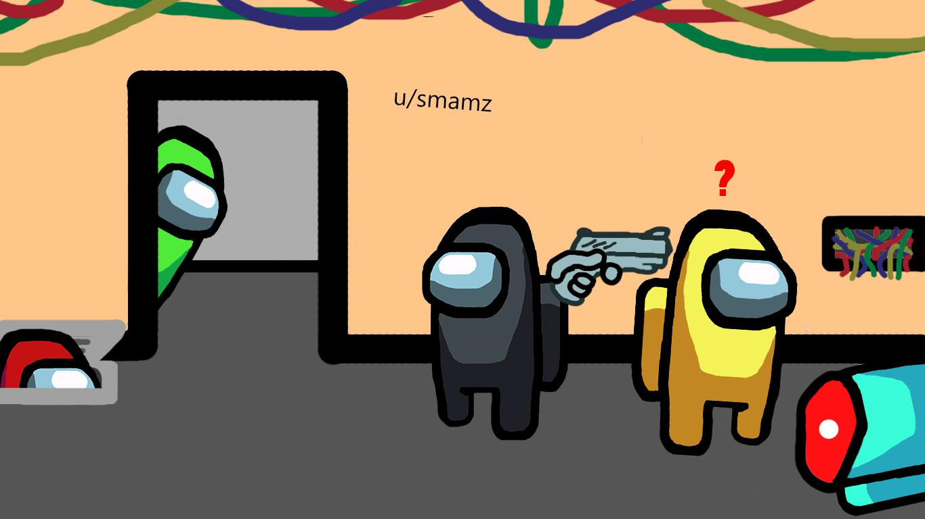
Characters

Slide 4
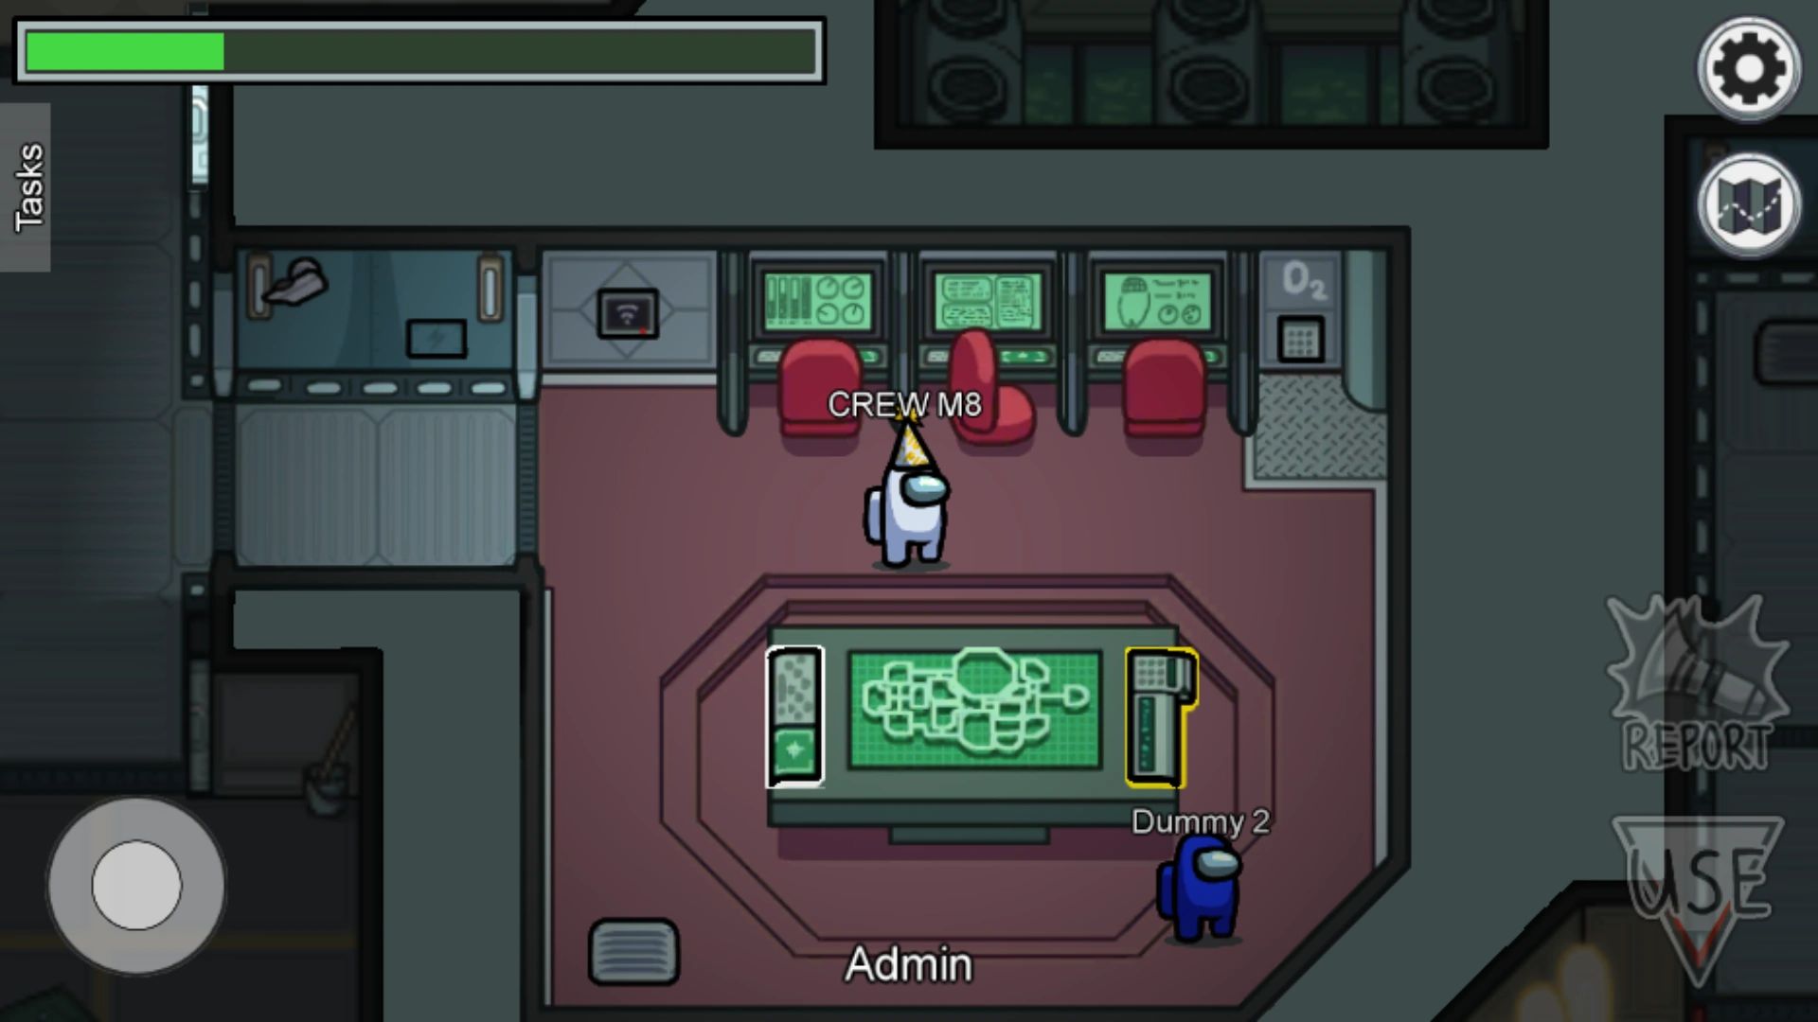
Our Idea

Slide 5
Thank You

